Slide 1
Virtual Reality - Albert Rizzo
Rishabh Singhal

Slide 2
Clinical Virtual Reality tools to advance the prevention, assessment, and treatment of PTSD

Slide 3
Introduction
The physical, emotional, cognitive, and psychological demands of a combat environment place enormous stress on even the best-prepared military personnel.
One emerging area of research is in the clinical use of Virtual Reality (VR) simulation technology as a tool for delivering evidence-based approaches for the assessment, prevention, and treatment of PTSD.
By its nature, VR applications can be designed to simulate naturalistic environments. Within these virtual environments, researchers and clinicians can present ecologically relevant stimuli embedded in a meaningful and familiar simulated context.
VR simulation technology also offers the potential to create systematic human testing, training, and treatment environments that allow for the precise control of complex, immersive, dynamic three-dimensional (3D) stimulus presentations, within which sophisticated interaction, behavioural tracking, user response, and performance recording is possible.

Slide 4
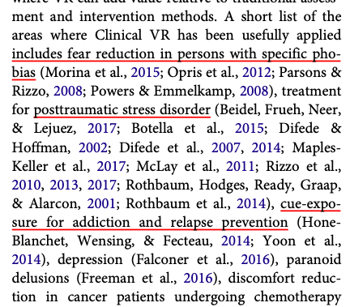

Slide 5
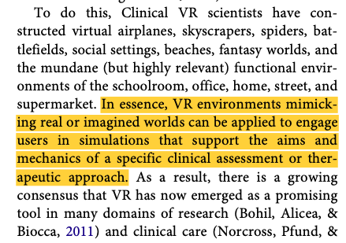

Slide 6
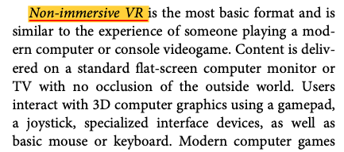
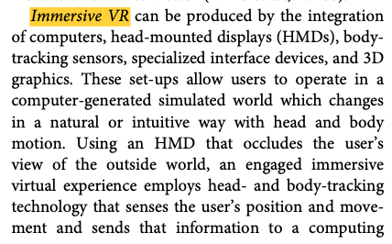

Slide 7
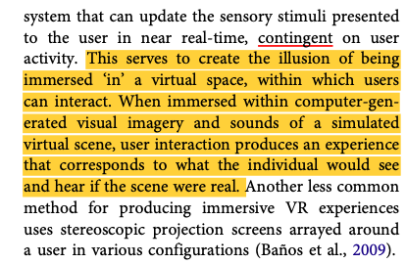

Slide 8
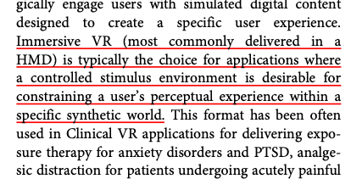
We can deliver any kind of virtual experience, in a constrained and controlled manner for research.

Slide 9
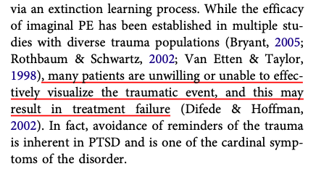
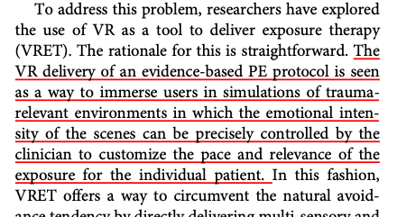
Prolonged Exposure and VRET

Slide 10
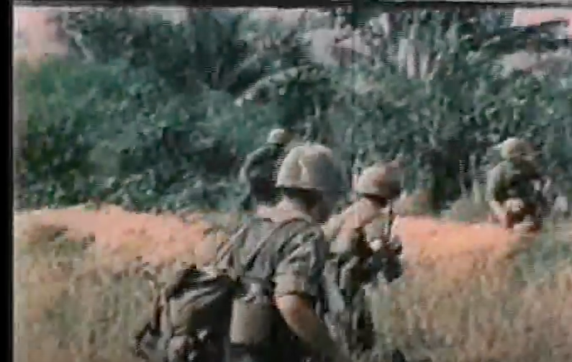
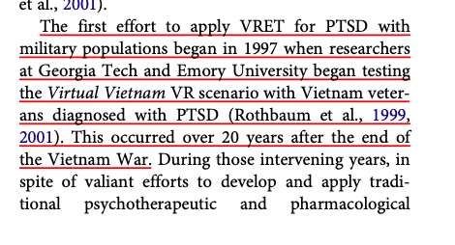
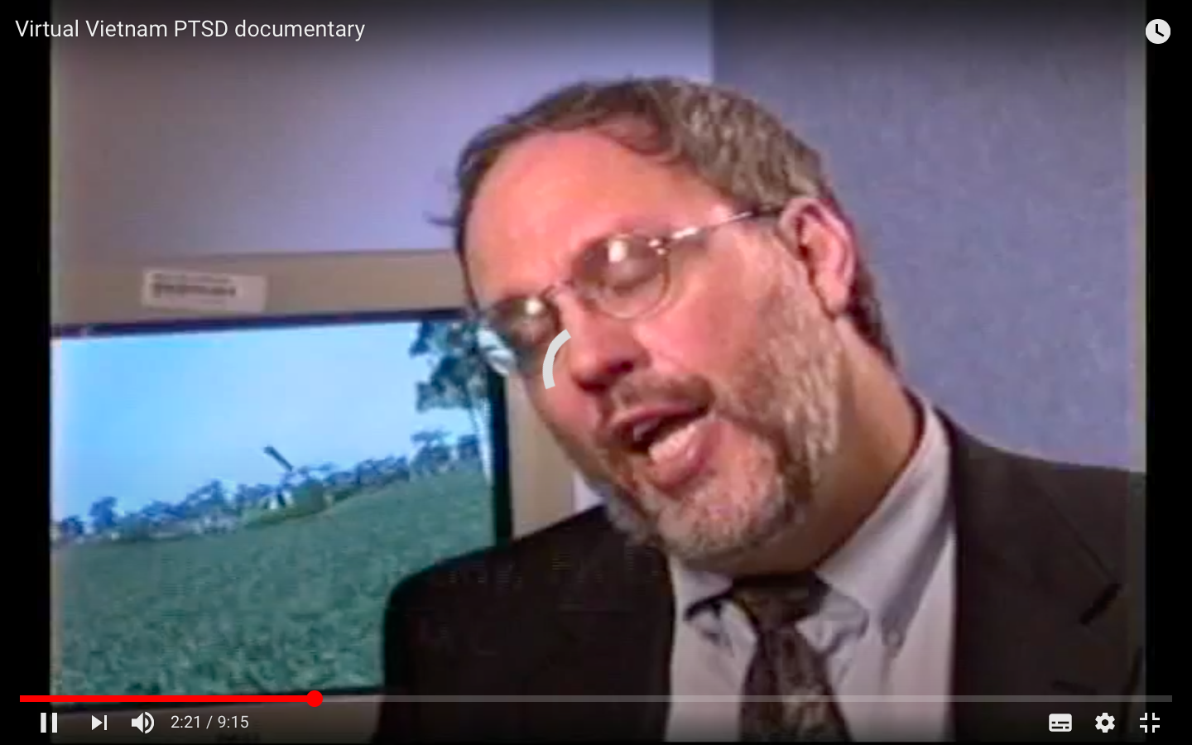
VRET and PTSD -- Virtual Vietnam
https://www.youtube.com/watch?v=C_2ZkvAMih8

Slide 11
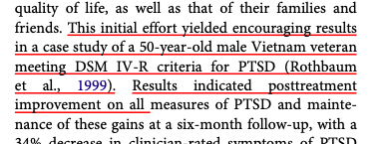
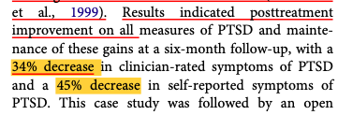

Slide 12
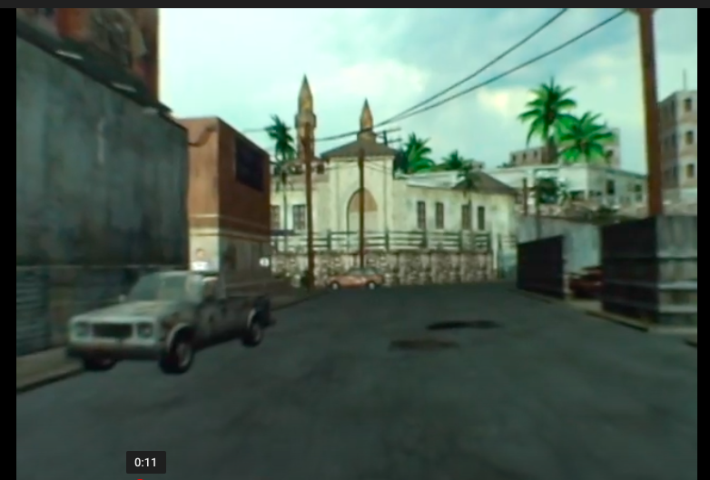
Virtual Iraq/Afghanistan and BRAVEMIND VRET
https://www.youtube.com/watch?v=zTtaK6mK3_c

Slide 13
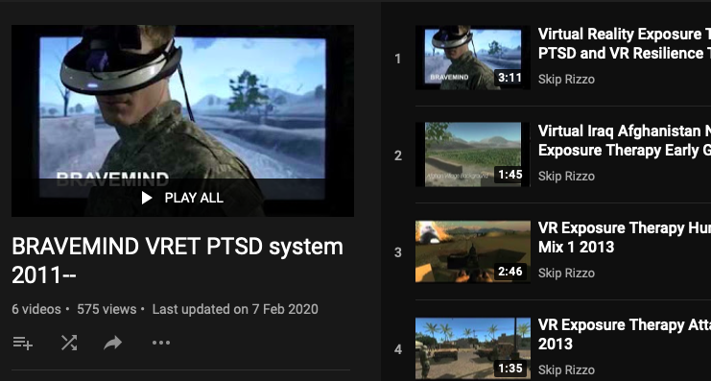
https://www.youtube.com/playlist?list=PLMuMO5eoYy_CnHj35tDGPYfR3fLDY0AyG

Slide 14
In addition to the visual stimuli presented in the VR head mounted display, directional 3D audio, vibrotactile, and olfactory stimuli of relevance can be delivered.

Slide 15
Clients’ experiences of VR scenarios and stimuli are controlled by a clinician in real time via a separate ‘Wizard of Oz’ (WoZ) control panel, while in full audio contact with the client during exposure.
-- 42 sec mark
https://www.youtube.com/watch?v=nrgUPVFY44o&list=PLMuMO5eoYy_CnHj35tDGPYfR3fLDY0AyG

Slide 16
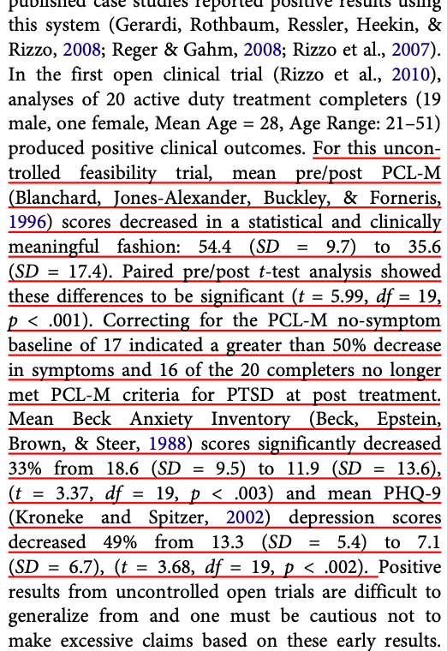
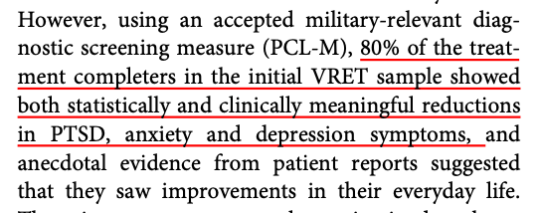
RESULTS --

Slide 17
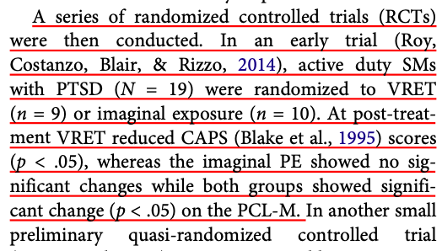

Slide 18
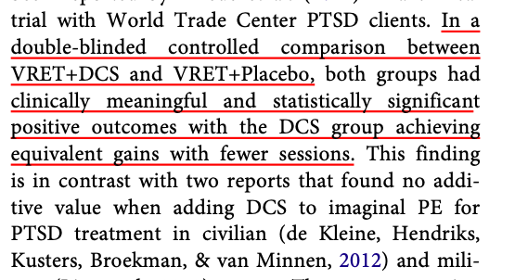
augmented by D-cycloserine (DCS), which has been found to facilitate extinction in other fear-based disorders

Slide 19
Virtual Reality and Resilience training

Slide 20
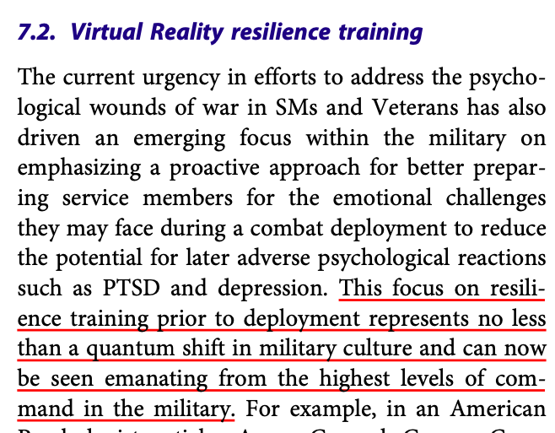

Slide 21
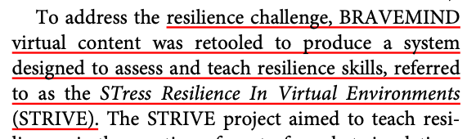

Slide 22
This approach involves immersing and engaging SMs within a variety of virtual ‘mission’ episodes where they are confronted with emotionally challenging situations that are inherent to the OEF/ OIF/OND combat environment.
https://www.youtube.com/playlist?list=PLMuMO5eoYy_AgK3ZWznPlTvFNjwKkXK9X

Slide 23
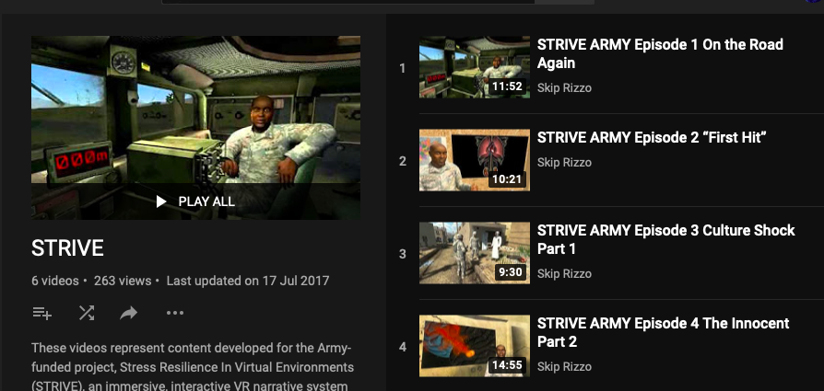

Slide 24
In those tests, SMs (n = 92) reported high positive ratings (88–100%) of the STRIVE episodes for preparing for and promoting knowledge, visualization, and rehearsal of stressful events to improve survival in a combat environment (Squad Overmatch, 2015). An initial pilot test of the physiologically activating effects of the first four STRIVE mission challenges was conducted with a sample of USC ROTC Cadets (n = 39) ( Wellman et al., submitted).

Slide 25
HRV
Participants who experienced the four STRIVE mission challenges had Fast Fourier transformation of heart rate variability (HRV) measured to infer emotional impact during participation.
Significant Low Frequency/High Frequency (LF/HF) ratio changes were seen across all but one event.

Slide 26
Future technical development aims to leverage a low-cost mobile-phone enabled consumer HMD (Samsung Gear VR) to support the widespread dissemination and independent SM practice of this and other military relevant content.

Slide 27
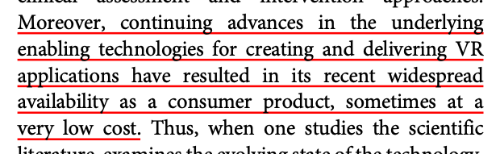
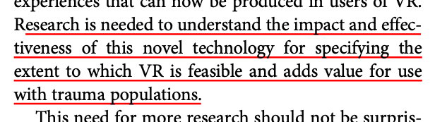

Slide 28
Making treatment more accessible is an important factor for promoting help-seeking in potential clients who live in remote locations or who encounter transportation or work scheduling challenges.
The similar use of VR as a tool for pushing trauma-relevant care outside of the clinic is still somewhat limited by cost and complexity issues, as well as by ethical concerns.
Promoting client adherence to a full course of trauma-focused treatment is a significant challenge with PTSD populations

Slide 29
Challenge
Barrier to care concerns the availability of well-trained providers who are properly trained and certified in evidence-based trauma interventions
VRET has an added challenge in this area as it does require some specialized training in the operation of VR equipment.
However, the impact of this is lessened by the fact that VRET follows the same procedures and mechanics as specified in the standard protocol for the delivery of imaginal PE (Foa, Hembree, & Rothbaum, 2007) and use of the equipment can be learned in a half-day training session.

Slide 30
Alternatively, the use of VH patients to facilitate clinical expertise may offer a convenient and less labour intensive approach for providing experiential clinical training to reduce the impact of this barrier.
While programmes that use virtual patients for clinical training are still in their infancy, this area is expected to grow in the near future as virtual human technologies are rapidly evolving.

Slide 31
The acceptability of seeking care can be improved by reducing the internal or external perceptions of stigma that a client may feel when seeking clinical help.

Slide 32
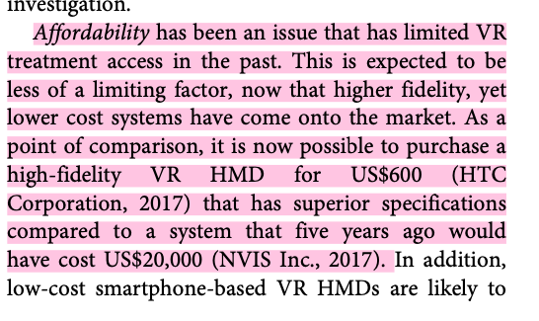

Slide 33
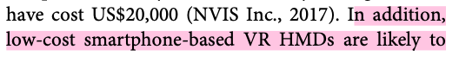
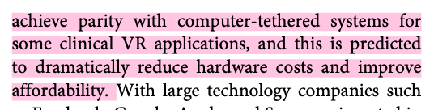
With large technology companies such as Facebook, Google, Apple, and Samsung invested in the VR market, we anticipate new and affordable hardware and software to be released more frequently over the next few years.

Slide 34
IDEAS...

Slide 35
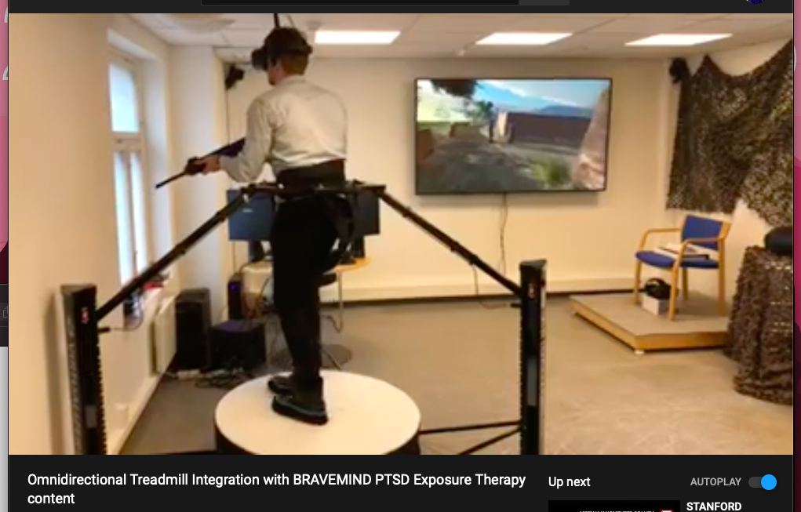
https://www.youtube.com/watch?v=MyaOvwo_8Ts

Slide 36
DONE!!

